Slide 1
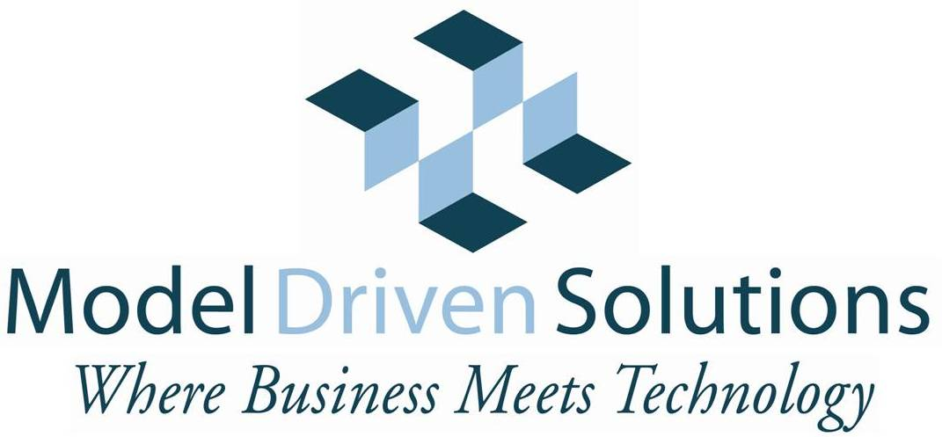
SMIF Update Enterprise Semantic Concept Modeling
Cory Casanave, Model Driven Solutions
2019

Slide 2
Two major parts of SMIF
Enterprise Semantic Modeling
Information Federation / Transformation
Currently Being Used with Enterprise Clients
Focused on concepts meaningful to and describing the business – a part of business architecture
Expression as a UML profile being refined to be published as open source on “https://semanticmodels.org/”
Simplified meta-model being developed that will become part of the specification
Not intended to commit to a particular logic
Lower-level subset Mapping to description logic being developed in a collaborative effort, probably a part of ODM
Implemented in NoMagic CCM
Initial submission had its own mapping/federation model
Leverages the enterprise model as a “pivot point” for integration and federation
Currently working with the “MDMI” spec to provide federation

Slide 3
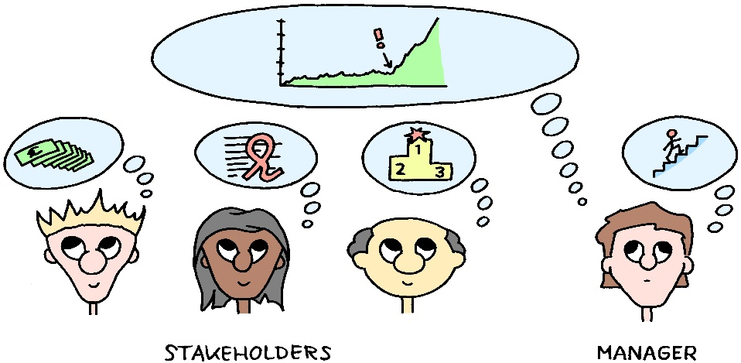

Semantic Models are Understandable and precise
Capture, disambiguate and precisely describe stakeholder business semantics .
Represent business semantics so stakeholders can understand and validate them.
Leverage business semantics with automation.

Slide 4
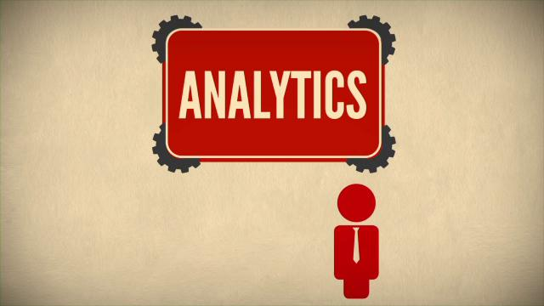
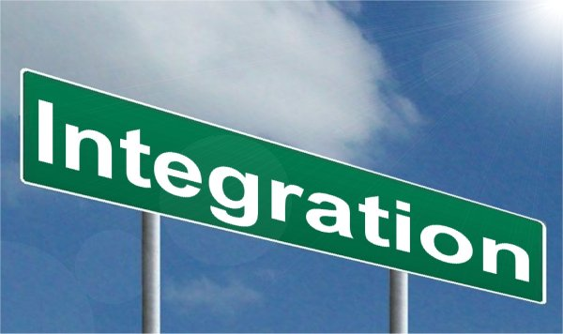
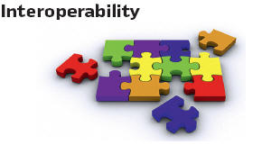



Leveraging Semantics
T

Slide 5
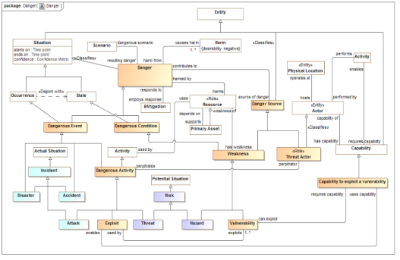
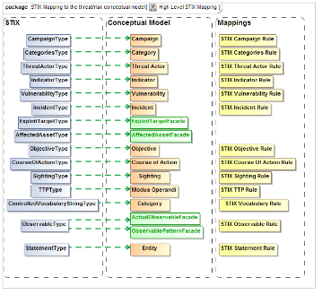
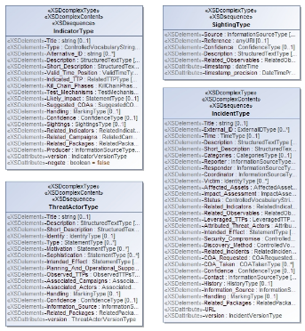
Data Represents Concepts
We need to understand
What the common concepts are
How do the various information syntaxes represent those concepts
What the are rules for translating between schema in various context
Information
Syntax
Represents
Reference
Concepts
Information
Syntax
Represents
Represents
Information
Syntax
Semantic Concept Model
Mapping Rules
Data & Message
Models

Slide 6
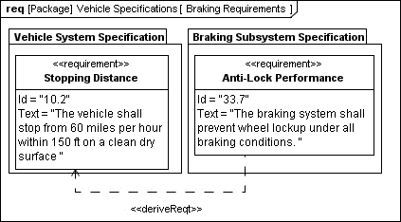
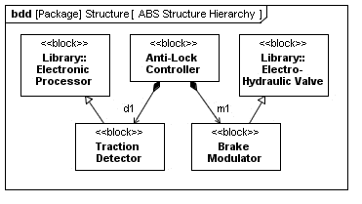
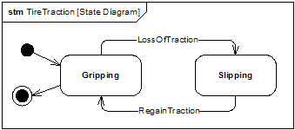
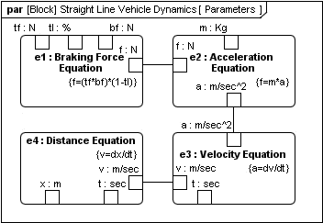
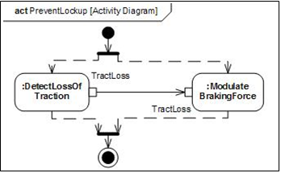
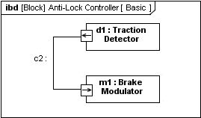





Problem: Uniform Interpretation
Using Modeling
Language
Model
«executes»
«interprets»
«interprets»
Semantics
Semantics
Interpreting the
Model
«implementedBy»
Manually
Automatically
«controlledBy»
«controlledBy»
«implementedBy»
Things
Being Modeled
‘Real World’
Source: Conrad Bock, SysML-2 Semantics

Slide 7
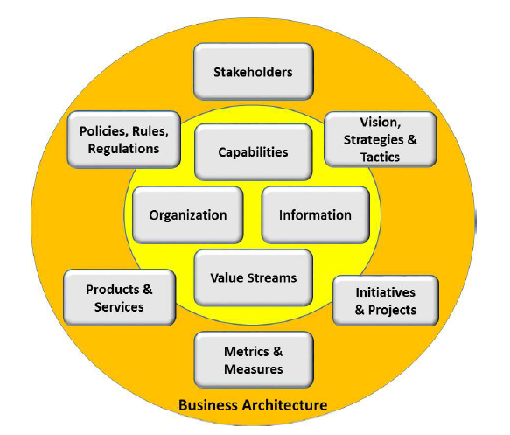
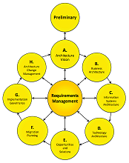
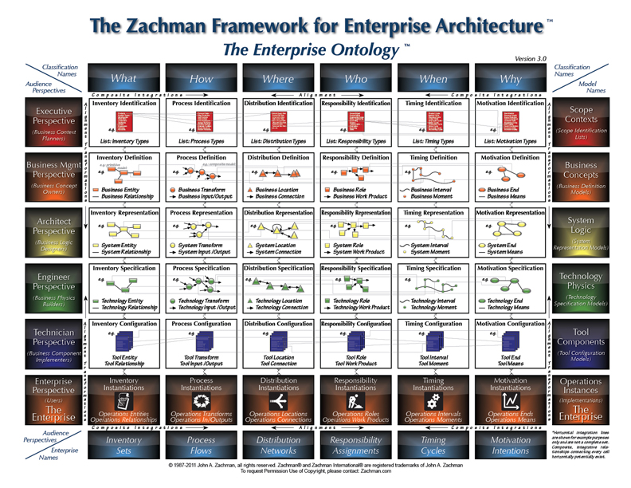
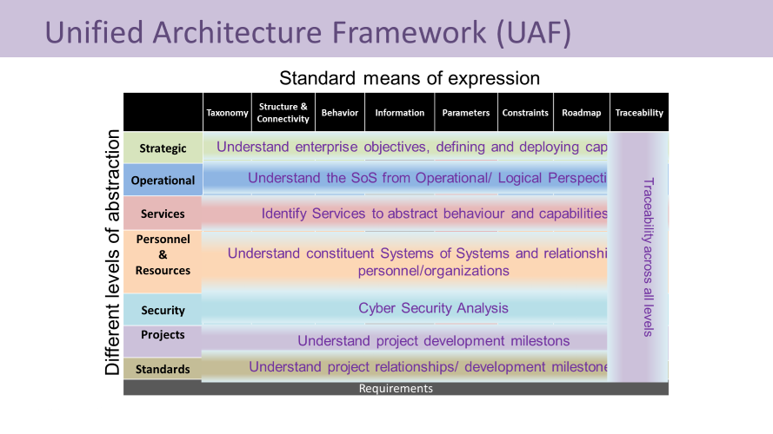
Every mature architecture framework recognizes interconnected viewpoints
Connected
Viewpoints

Slide 8
Connected Viewpoints & Perspectives - Architecture and Governance
Value
Information
Capabilities
Service
Rules
Organization
Security
Governance
Business
Our Focus
Business Motivation & Value
Semantic Concept Model
Business Capabilities & Process Model
Business Services Model
Business Rules
Organization Model
Security & Privacy concerns
Business Governance
Logical
Capabilities & Value Provided
Logical Data Model
Application flow & logic
Logical SOA model
Application Logic or rules engine
Roles & Responsibilities
Control Objectives
Security & privacy
Physical
Physical Data Model
Application logic and/or BPM engine
API
Application deployment
Individuals & applications fulfilling roles
Implementation of controls
Authorization & Monitoring

Slide 9

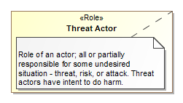
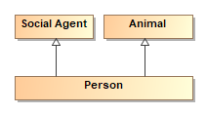

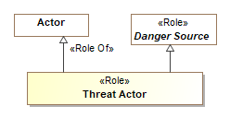


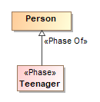
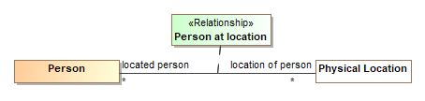
Essential Modell Conceptual Tools (Meta-Concepts)
Entity Types
Definitions
Specialization
Characteristics
Roles
Associations (Always true between entities)
Values & Units
Phases
Relationships (Independent/Contextual)

Slide 10
Changes and Additions

Slide 11
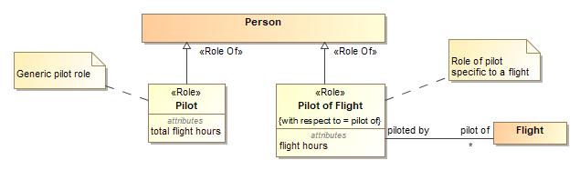
Roles – With Respect To
There are two levels of “role”, those specific to the entity generically and those with respect to something else

Slide 12
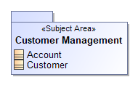
Subject Areas (Stereotype of Package)
Business Level Organizational Structure for Business Concepts

Slide 13
Simplification of Meta Model
Experience using SMIF
High-level view of information concepts, not data model, very valuable
Federation
Application Integration
Data Governance
Portfolio Management
Need to push simplified information out to other tools like Collibra and Troux
Simplification of meta model can be more enterprise useful
Many of the constraints in the current model structure will move to OCL

Slide 14
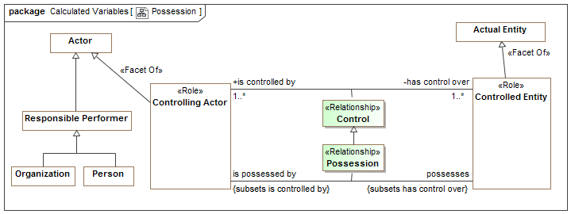
Example of Modeling Style (UML Profile)
Control Possession relationships are “first class” – have a timeframe, can be part of cause and effect, etc.
“Controlling Actor” is a role – people and organizations can play this role
Both entity classes and relationships form hierarchies
There are multiple ways “data structures” could be arranged to represent this information or a subset of it – that is the subject of mappings.

Slide 15
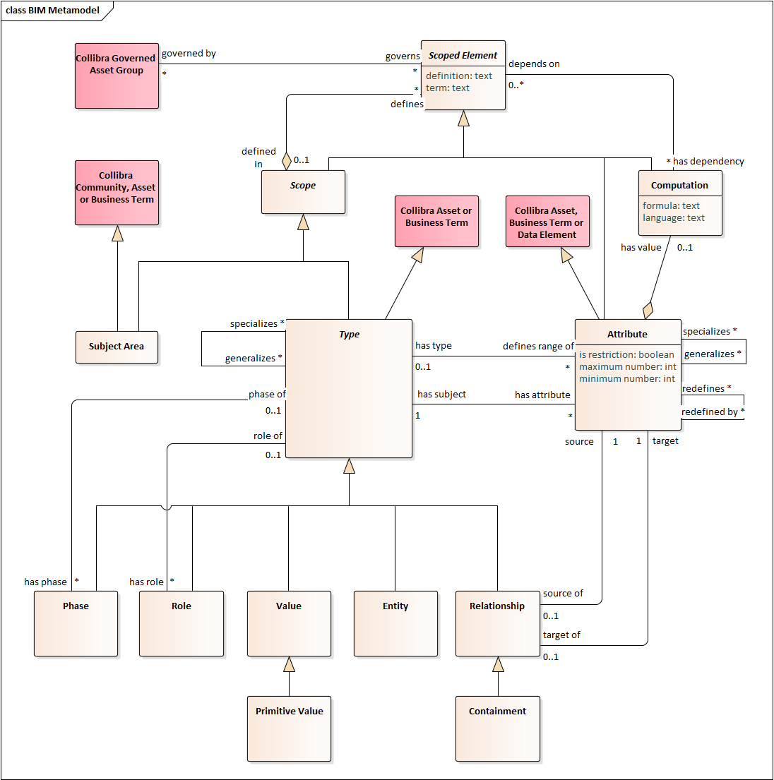
Example of integration of SMIF models with external tools (Collibra in this example)
In this case Collibra could be extended to capture business concepts
This can then be use as a basis for “merging” data concepts for governance

Slide 16
Drill-down to enhanced reasoning
Essential model provides some foundation for automation and reasoning
But is not optimized for that purpose
Some things are hard for first order logic
The world is temporal
The world is “higher order”
Mapping to resonating applications is like any other MDA mapping to an executable system – from CIM to PIM to PSM
Business Model (CIM) is not “refined” for execution, it is a different model. Some parts can be automated with additional commitments
E.g. mapping to OWL makes description logic assumptions and commitments

Slide 17
What we want to do
Continue to get the SMIF “essential model” level in the market
Continue to Gain experience
Publish a simplified revised submission

